Slide 1
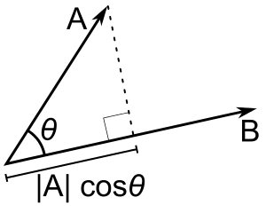
Supercharging Virtual Plant Configurations using Z3
Nikolaj Bjørner, Max Levatich,
Nuno Lopes, Andrey Rybalchenko,
Chandra Vuppalapati
Microsoft

Slide 2

1
Introduction and overview of
2
for virtual plant design automation

Slide 3
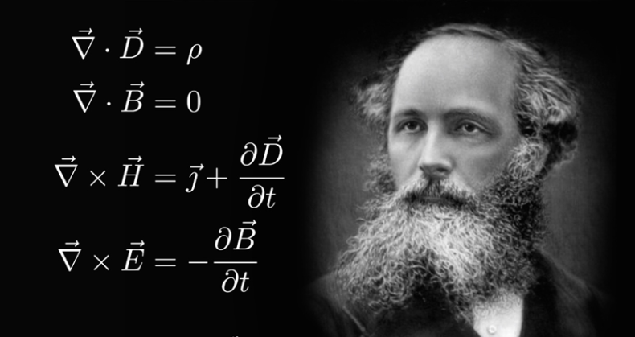
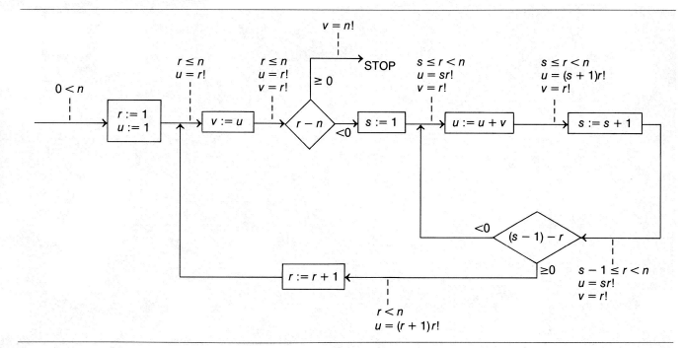
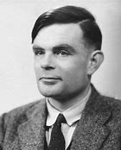
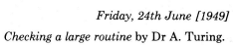
Logic: The Calculus of Computation
Invariants
Differential, Integral Calculus
Logic
Dynamics, Conduction,..
Matlab, Mathemetica, Simulink
Computation
Claim: Practically all modern program analysis tools involve solving logical formulas

Slide 4

Efficient Solver for Symbolic Logic
Text and Programmatic API
Formalism support datatypes used in software
Efficient search algorithms
+
Solvers tuned for datatypes used in software
(optimal)
Solution
Infeasible
Core
Consequences

Slide 5
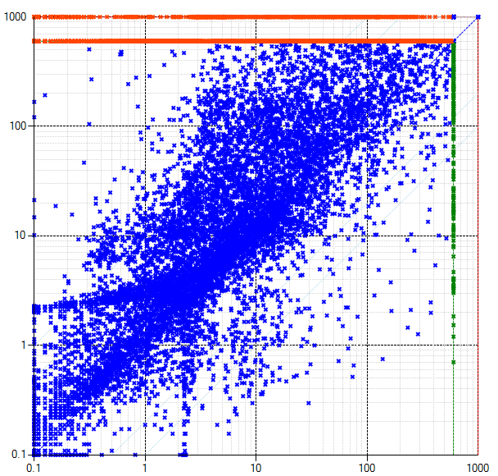
Symbolic Solving: Foundations and Engineering
old
algorithm
Solution
Conflict Resolution
Infeasible
new
algorithm
Core solvers in Z3 founded on duality between solution witness / infeasibility proof
Advances guided by application domains and evaluated by extensive benchmarking

Slide 6
Efficiency
Scale
Technology Landscape
Propositional
Satisfiability Solving
SAT
Breakthroughs in 2000s
Cheap local Inferences
Garbage collect useless clauses
Hardware Design
Automation
Breakthroughs late 2000s
SAT + global inferences +
global propagators
Mixed Integer
Programming
MIP
Breakthroughs in 1960s
Harnessed since 1990s
LP: global Inferences
IP: Cuts, Branch and Bound
Satisfiability Modulo Theories
Operations
Research
CP-SAT
SMT
Z3
Constraint
Programming
Software Development +…
CP
Breakthroughs since 1990s
Powerful domain-tailored
global propagators
Expressive Power

Slide 7
SMT Solvers – Main Services
Support domains that are natural in Software and Hardware analysis
Make it easy to translate program assertions into SMT
Holy grail of SMT: modularity + efficiency
Combine disjoint Theory Solvers by reconciling equalities between shared variables
Quantifier-Free First Order Theories
Int, Real, Bit-vectors, IEEE floating point numbers, arrays, algebraic data-types
Quantified First-Order, Higher-Order Logics
As aid to proof assistants

Slide 8
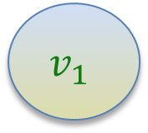
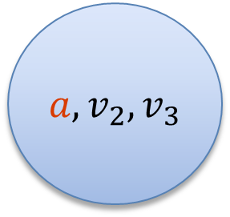
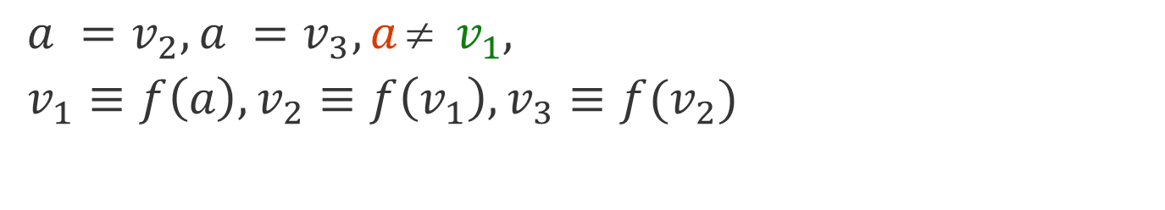
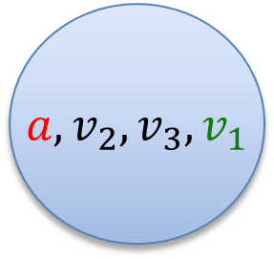
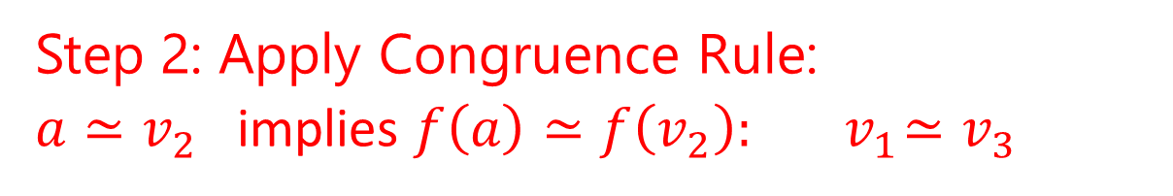
Base theory: Uninterpreted Functions
$$a = f(f(a)), a = f(f(f(a))), a  f(a)$$
Produce Proofs
Incremental Updates
Propagate Literals
$a =v_{2}, a =v_{3}, a  v_{1},$
$v_{1}≡f\left(a\right), v_{2}≡f\left(v_{1}\right), v_{3}≡f(v_{2})$
$a, v_{2}, v_{3}$
$$v_{1}$$
Union Find
Step 1: Equivalence classes from equalities
$a, v_{2}, v_{3}, v_{1}$
Step 2: Apply Congruence Rule:
$a≃v_{2}$ implies $f\left(a\right)≃f\left(v_{2}\right):{ v}_{1}≃v_{3}$
E-graph

Slide 9
Compiled into SAT: Bit-vectors
Bit-vector addition is expressible
using bit-wise operations and
bit-vector equalities.
x
1
0
1
0
1
1
out = xor(x, y, c)
c’ = (x∧y)∨(x∧c) ∨ (y∧c)
c[0] = 0
c’[N-2:0] = c[N-1:1]
+
y
0
1
1
0
0
1
Benefits:
- Efficient finite domain reasoning
Limitations:
- Not suitable for heavy use of linear arithmetic
- Bit-vector multiplication is super expensive
c
FA
FA
FA
FA
FA
FA
Note:
x y c
c’ out
out ↔ xor(x, y, c)
c’ ↔ (x∧y) ∨ (x∧c) ∨ (y∧c)
out
0
0
0
1
0
0
FA

Slide 10
Combining Theories in the age of CDCL(T)
Foundations
Efficiency using rewriting
1979 Nelson, Oppen: Framework
1996 Tinelli & Harindi: N.O Fix
2000 Barrett et al: N.O + Rewriting
2002 Zarba & Manna: “Nice” Theories
2004 Ghilardi et al: N.O. Generalized
1984 Shostak: Theory solvers
1996 Cyrluk et al: Shostak Fix #1
1998 B: Shostak with Constraints
2001 Rueß & Shankar: Shostak Fix #2
2004 Ranise et al: N.O + Superposition
1998 de Silva, Sakallah; 2001 Moskewicz et al: DPLL → CDCL made guessing cheap
2006 Bruttomesso et al: Delayed Theory Combination
2007 de Moura & B: Model-based Theory Combination

Slide 11
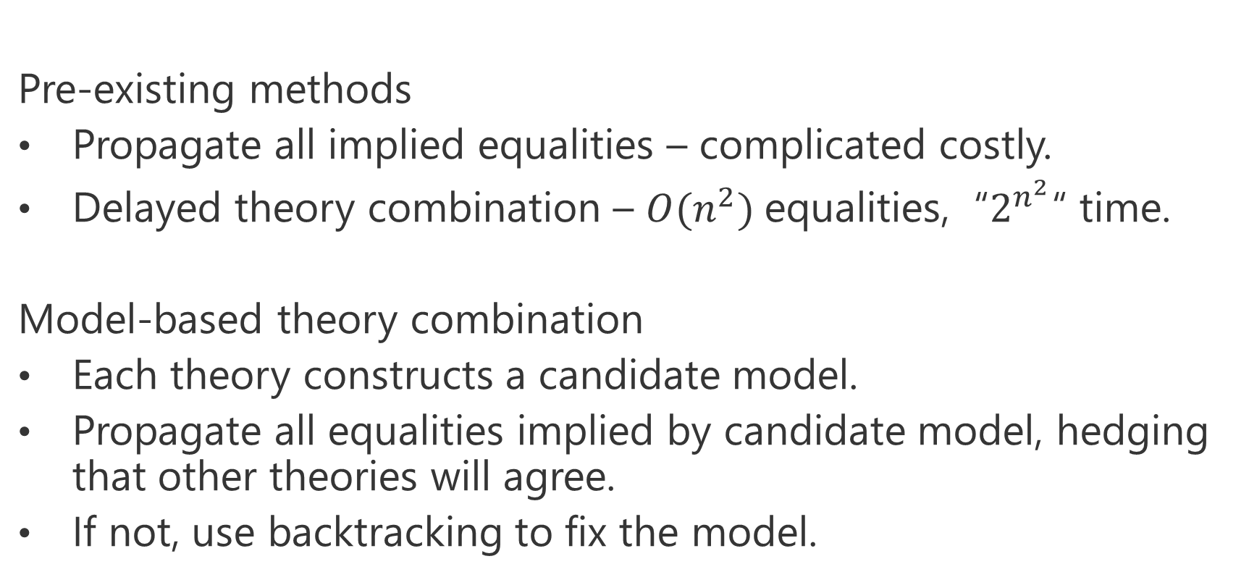
Model-based theory combination
Pre-existing methods
Propagate all implied equalities – complicated costly.
Delayed theory combination – $O(n^{2})$equalities, “$2^{n^{2}}$“ time.
Model-based theory combination
Each theory constructs a candidate model.
Propagate all equalities implied by candidate model, hedging that other theories will agree.
If not, use backtracking to fix the model.
Solution
Conflict Resolution
Infeasible

Slide 12
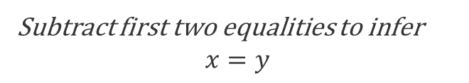
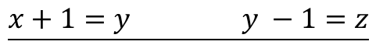
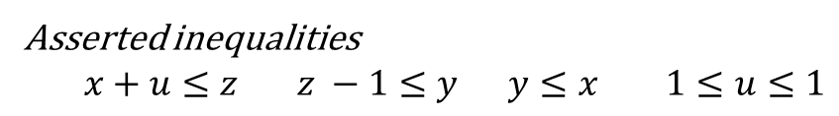
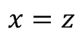
Propagating Equalities
Equality inferences require addition/subtraction operations
Asserted inequalities
$x+u≤z z −1≤y y≤x 1≤u≤1$
$$\underline{x+1=y y −1=z}$$
$$x=z$$
How the solver sees the constraints
$x+u+s_{1}=z z −1+s_{2}=y y+s_{3}=x 1≤u≤1 0≤s_{1} 0≤s_{2} 0≤s_{3}$
After pivoting
$$x=z−u −s_{1} y=z −1+s_{2} s_{3}={−s}_{2}− {u+1− s}_{1} 1≤u≤1 0≤s_{1} 0≤s_{2} 0≤s_{3}$$
After propagating bounds on $s_{1}, s_{2},s_{3}$
$$x=z−u −s_{1} y=z −1+s_{2} s_{3}={−s}_{2}− {u+1− s}_{1} 1≤u≤1 0≤s_{1}≤0 0≤s_{2}≤0 0≤s_{3}≤0$$
Subtract first two equalities to infer
$$x=y$$
Subtle complexity: Every row can have many fixed variables. Adding values of constant bounds requires significant runtime.

Slide 13

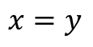
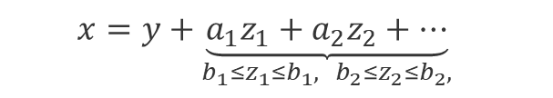
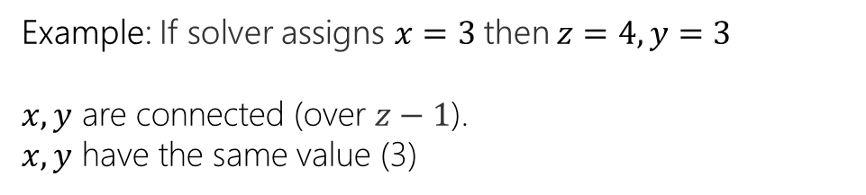
Propagating Equalities - Efficiently
$$\underline{x=z−u −s_{1} y=z −1+s_{2} 1≤u≤1 0≤s_{1}≤0 0≤s_{2}≤0 0≤s_{3}≤0}$$
$$x=y$$
Instead of adding up rows to prove implied equality
Use fact: all variables have values assigned by Simplex solver
Then two variables are equal if
They are connected through offset equalities
They have the same value
offset equality
$$x=y+{\underset{{b_{1}≤z}_{1}≤b_{1}, { b}_{2}≤z_{2}≤b_{2},}{\underbrace{{a_{1}z}_{1}+a_{2}z_{2}+…}}}_{}$$
Example: If solver assigns $x=3$ then $z=4, y=3$
$x, y$ are connected (over $z−1$).
$x, y$ have the same value (3)
[Lev Nachmanson, B]

Slide 14
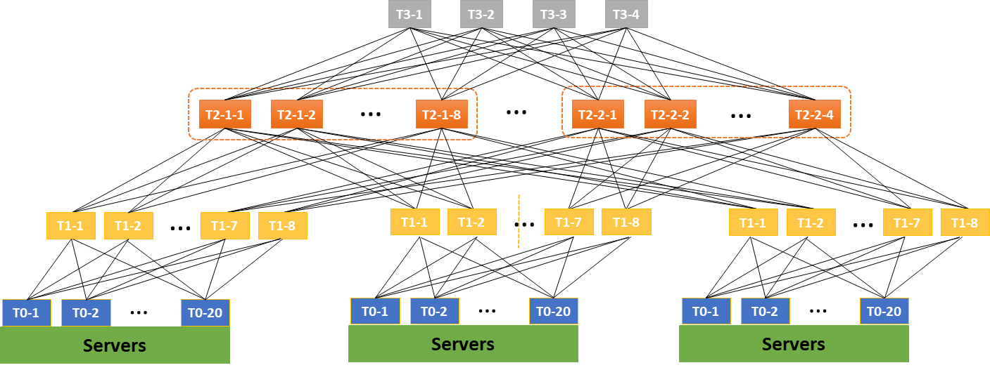

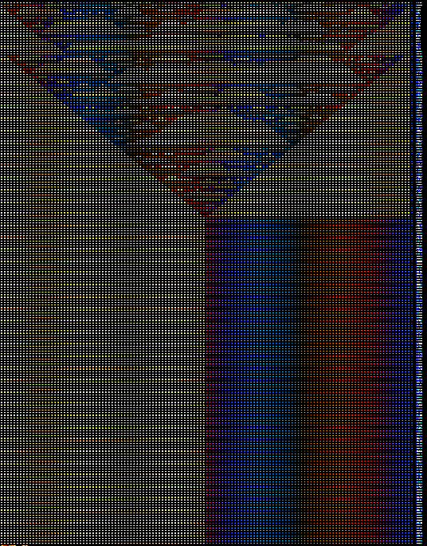
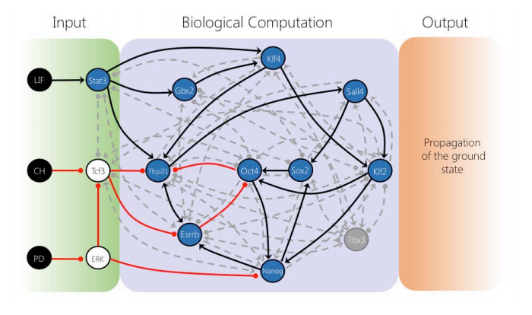



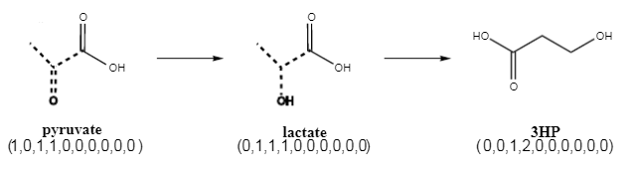


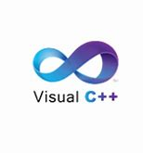
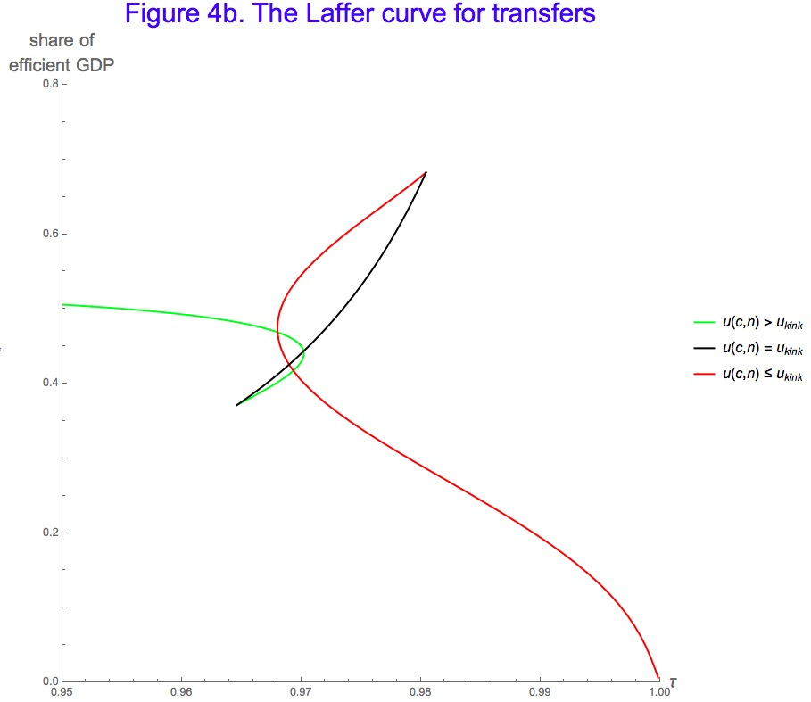


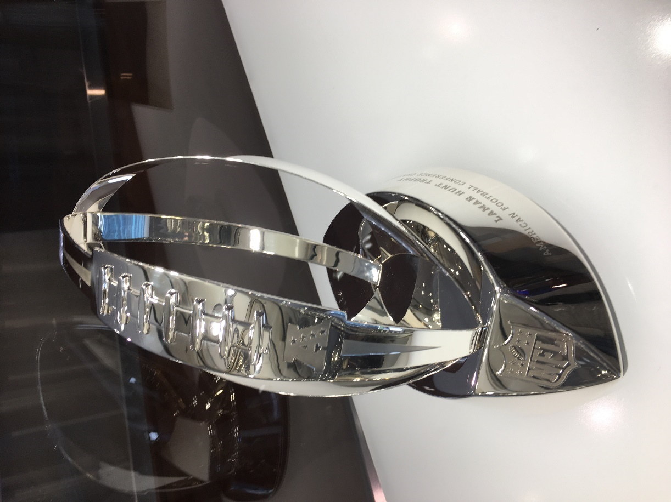
for Software +…
Azure Network
Verification
Verifying C
Compiler
Quantum
Compilation
Biological
Computations
Verified Crypto
Libraries & Protocols
Dynamics
AX
SVACE
Static Analysis Engines
Artificial
Life
Security Risk Detection
Smart Contract
Verification
ALIVE2
Translation Validation
for LLVM & Visual C++
Axiomatic
Economics
NFL
Scheduling

Slide 15


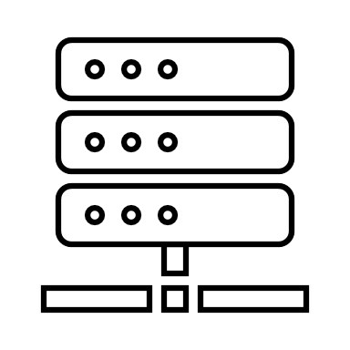


Live Monitoring of Forwarding Behavior
Global reachability as local contracts
Each router has a fixed rule for a set of addresses
Enough to verify rule is enforced on each router
R₁
R₂
R₃
R₄
Topology Database
D₁
D₂
D₃
D₄
Reachability
invariants
A₁
A₂
A₃
A₄
B₁
B₂
B₃
B₄
ToR₁
ToR₂
ToR₃
ToR₄
Error Reports
10.0.0.0/16
11.0.0.0/16
12.0.0.0/16
13.0.0.0/16
5 Billion Z3 queries per day
[Jayaraman et al, Sigcomm 2019]

Slide 16

Alive2: Integration with LLVM
C, C++, ObjC, Rust,
Swift, …
frontend
llvm2alive
static unroll
encode semantics & refinement check
LLVM IR
Alive2 IR
Alive2 IR
LLVM middle-end optimizers
SMT formulas
LLVM IR
Alive2 IR
Alive2 IR
clang, rustc, etc
LLVM
Alive2
UNSAT or partial model
clang w/ alive2 plugin:
$ alivecc file.c
opt plugin:
$ opt -tv -instcombine -tv file.ll
[Nuno Lopes, Juneyoung Lee, Chung-Kil Hur,
Zhengyang Liu, John Regehr, PLDI 2021]
Notes:
Alive2 integrates straightforwardly with LLVM. First you use the front-end as usual to produce LLVM IR from your favorite language. Then Alive2 snapshots that code. Then we optimize it using LLVM, and again snapshot it. Then, since we do bounded translation validation, Alive2 unrolls loops by a fixed amount.
Finally, Alive2 encodes the semantics of the program before and after optimizations, including all of the undefined behaviors, and encodes the refinement checks as well. These formulas are then discharged automatically using Z3.

Slide 17






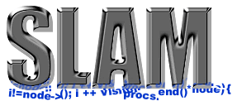


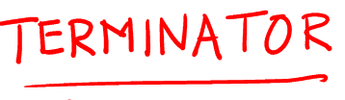


SecGuru
Tools and internals developed
in a feedback loop
SLS, floats
νZ: Opt+MaxSMT
μZ: Datalog
Generalized PDR
Existential Reals
Model Constructing SAT
CutSAT: Linear Integer Formulas
SAGE
Tools
Quantified Bit-Vectors
Internals
Linear Quantifier Elimination
Model Based Quantifier Instantiation
Generalized, Efficient Array Decision Procedures
HAVOC
Engineering DPLL(T) + Saturation
Effectively Propositional Logic
Model-based Theory Combination
Relevancy Propagation
Efficient E-matching for SMT solvers
Notes:
Models are very important.
Classical theorem provers do not produce models

Slide 18
Z3 for Virtual Plant Design Automation
An ongoing collaboration

Slide 19
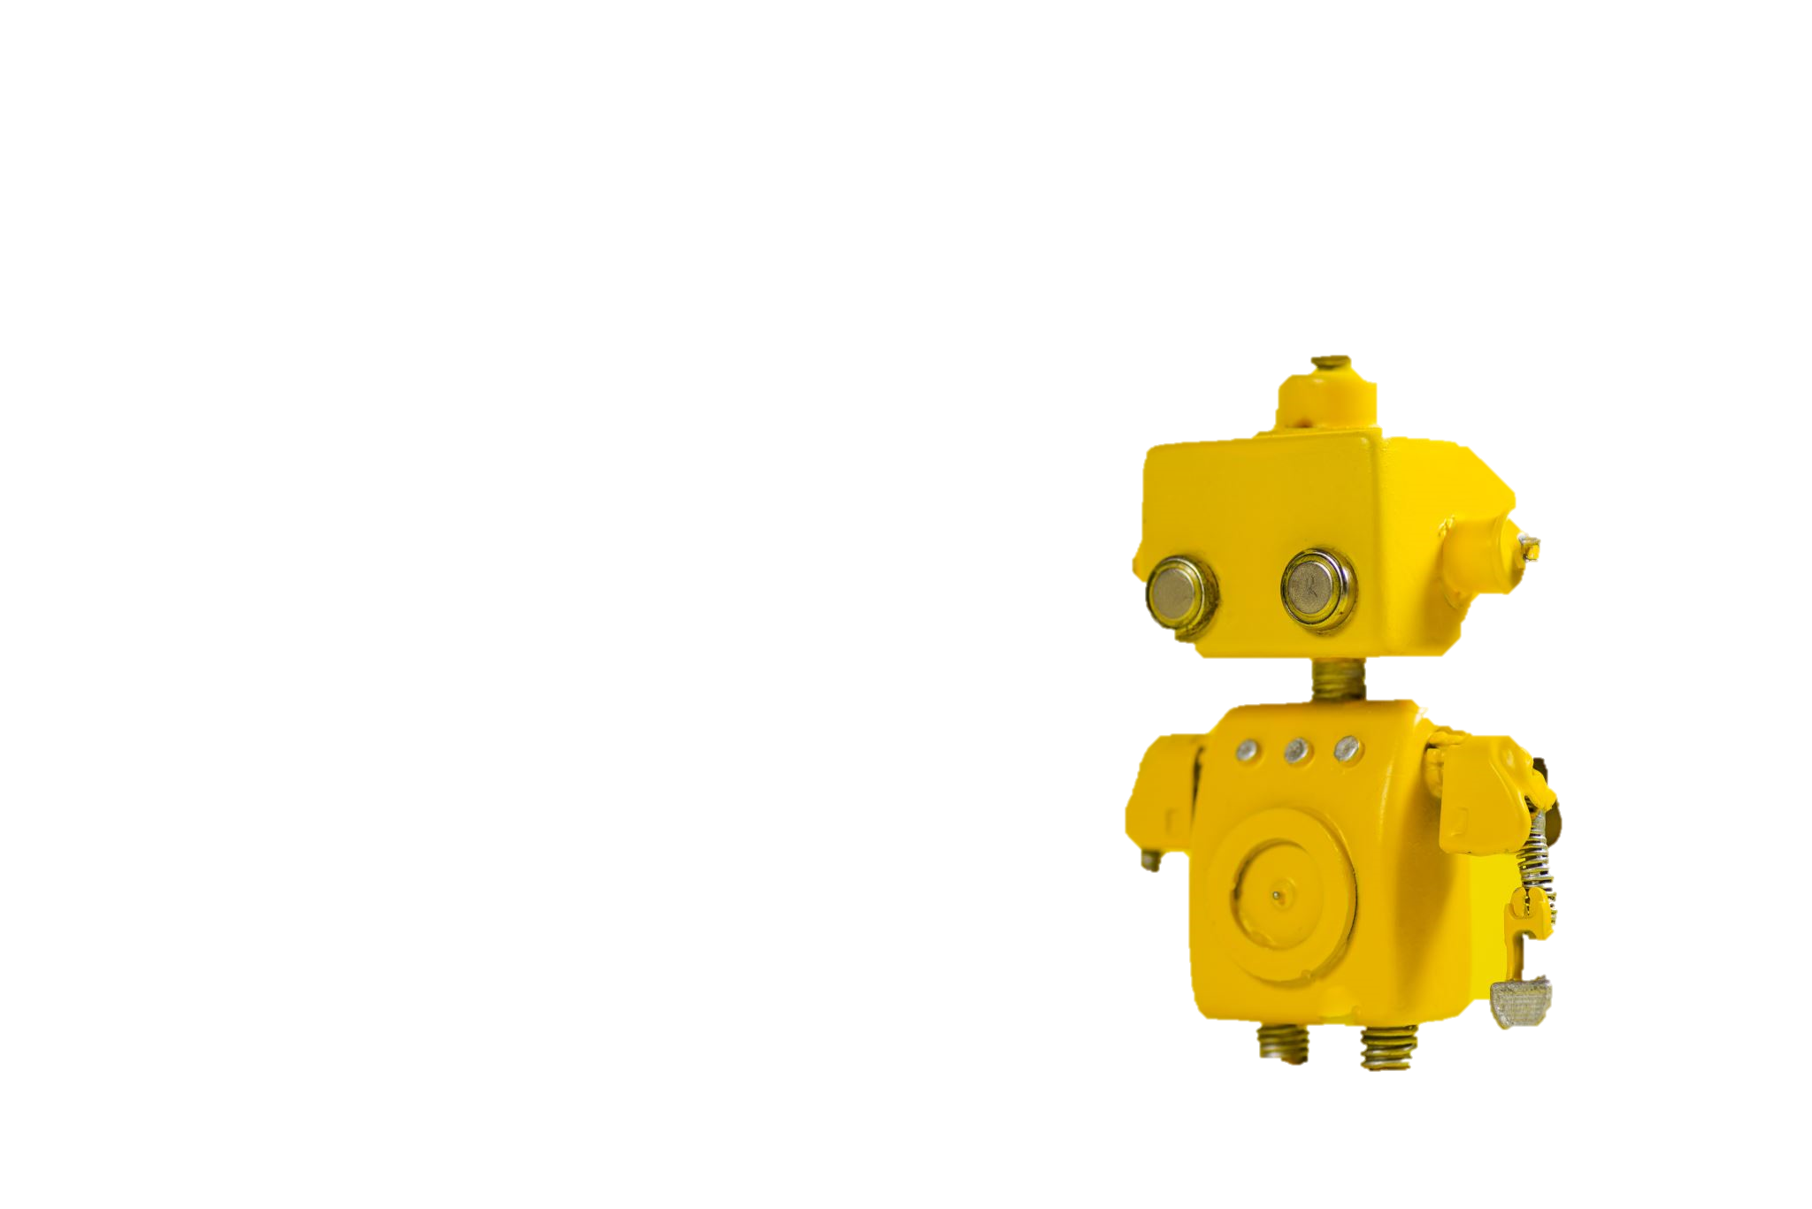

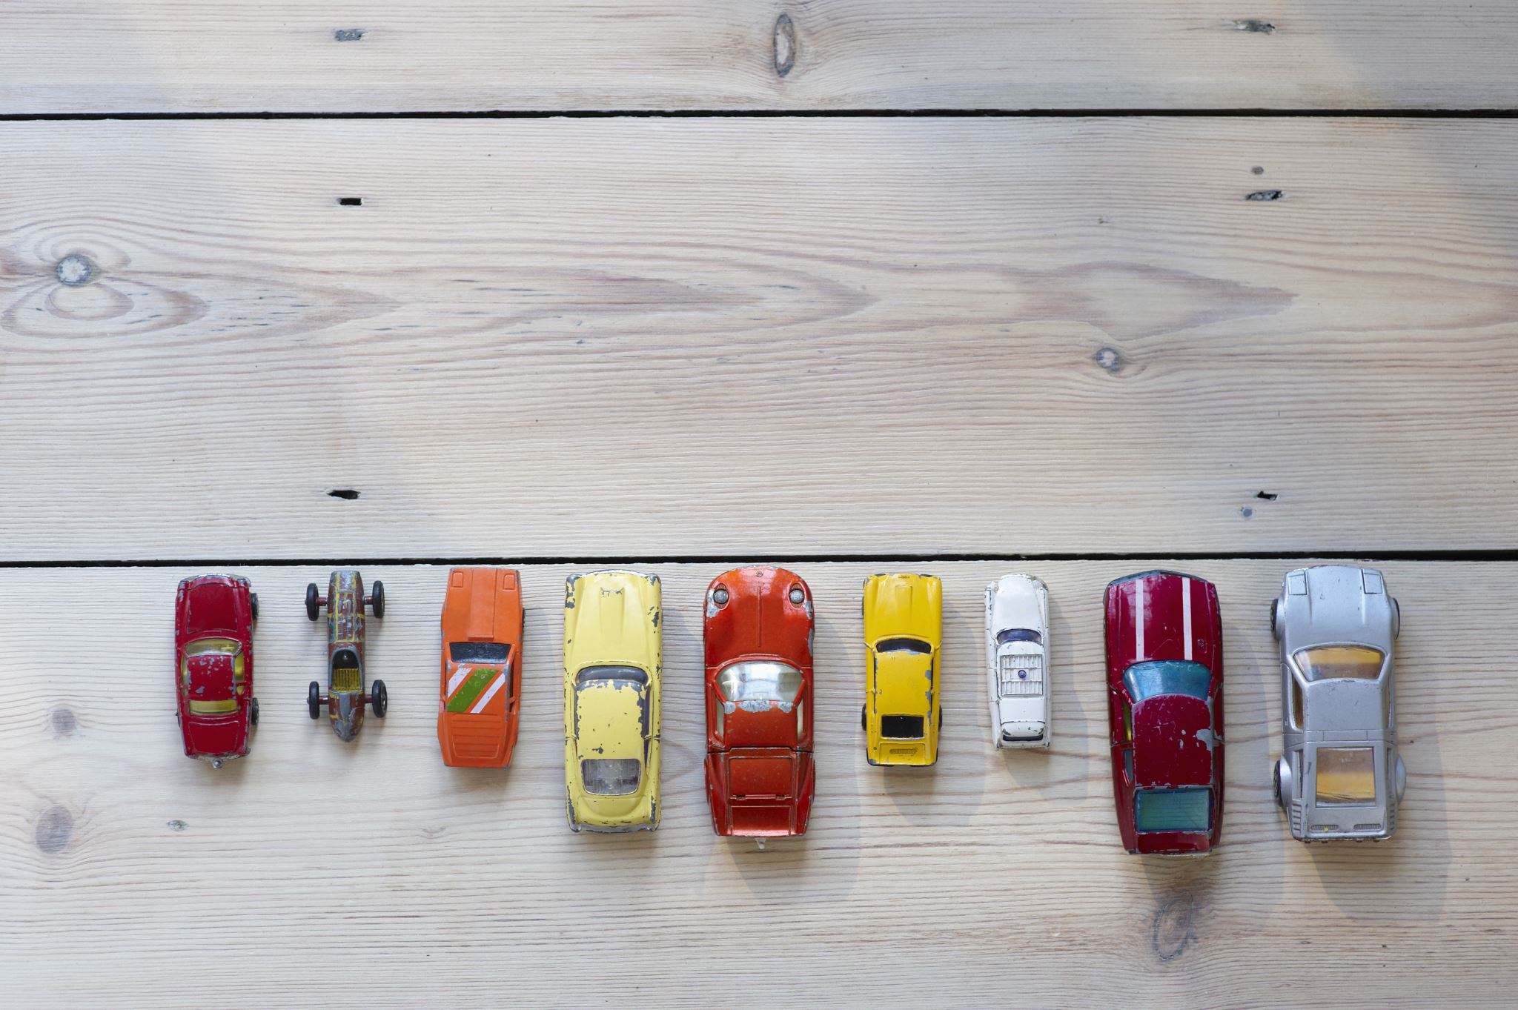

Solving Virtual Plants (in a nutshell)
Solve for:
Assign every task to a station and an operator
Subject to:
Bounded completion time
Partial order of stations and processes
What operations stations can perform
Objectives:
Minimize resource consumption
Minimize operator congestion
Enable:
Automate manual puzzle
Optimize over design space
Scale and be nimble: new factories, new models
Track and manage inventory
Process
Task 1
Task 2
Task 3
Task 4
Task 5
Task 6
Process
Task 1
Task 2
Task 3
Task 4
Task 5
Task 6
Process
Task 1
Task 2
Task 3
Task 4
Task 5

Slide 20
Experiences Summary
Domain Engineering
Solver Engineering
Model Formalization
Data Validation
Constraints
as Code
Develop mathematically precise model
Small Batches
1 process
at a time
Full Model
Visualization
Integers + Uninterpreted Functions
Bit-vectors
+ UF
Relational Object Model of SQL data
Semantic validation
of SQL data
Full Encoding
CSP based on Z3
Partial Encoding
Solved 10% in 20 hrs
Solved 80% in 10 hrs
Dead end
Solved 100% in 3 min

Slide 21
Experiences Summary
Domain Engineering
Solver Engineering
Model Formalization
Data Validation
Constraints
as Code
Develop mathematically precise model
Small Batches
1 process
at a time
Full Model
Visualization
Integers + Uninterpreted Functions
Bit-vectors
+ UF
Relational Object Model of SQL data
Semantic validation
of SQL data
Full Encoding
CSP based on Z3
Partial Encoding
Solved 10% in 20 hrs
Solved 80% in 10 hrs
Dead end
Solved 100% in 3 min

Slide 22
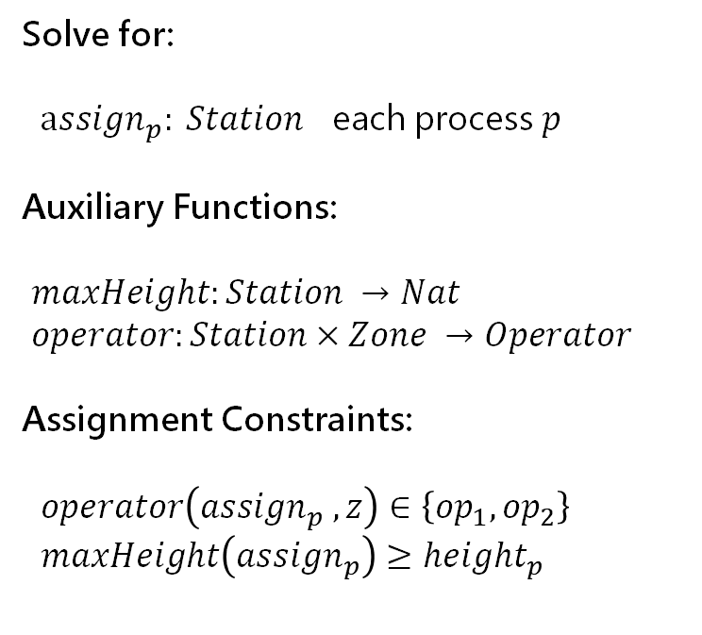
Domain Engineering – Mathematical Modeling
Solve for:
$assign_{p}: Station$ each process $p$
Auxiliary Functions:
$maxHeight:Station →Nat$
$operator:Station×Zone →Operator$
Assignment Constraints:
$operator\left(assign_{p} ,z\right)∈\left\{op_{1},op_{2}\right\}$
$maxHeight\left(assign_{p}\right)≥height_{p}$
Process
Task 1
Task 2
Task 3
Task 4
Task 5
Task 6
Process
Task 1
Task 2
Task 3
Task 4
Task 5
Task 6
Process
Task 1
Task 2
Task 3
Task 4
Task 5
Mapping to Z3 at same the level of model
Uninterpreted functions
Nested formulas (no tuning for big Ms)
Finite domains using bit-vectors
Research Angles
Mathematical concepts matured in tools for requirements capture (TLA+)
A sweet spot for Formal Methods skillsets
Uncovered many subtle implicit assumptions

Slide 23
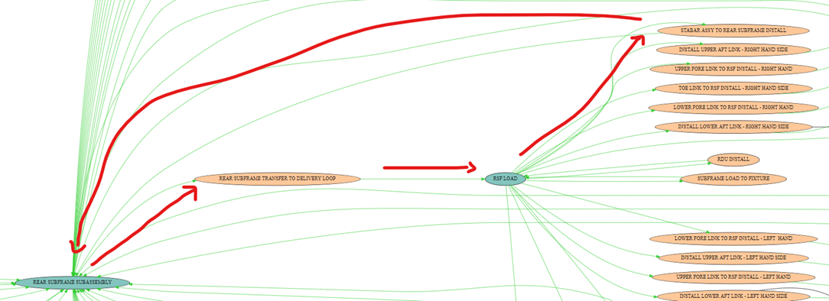


Domain Engineering – Semantic Validation
Grand
Goal
Humble
Path
Validation Approaches
1. Scripts that check invariants of
database entries
2. Provenance information
using infeasible cores from Z3
Z3 Features
Native core minimization in SAT solver
Core and correction set enumeration
Software bug localization and repair
Practical impact
Invariant checker and provenance tools in hands of collaborators
Used to fix a significant set of data entry bugs
Deep Solving
Deep Validation

Slide 24
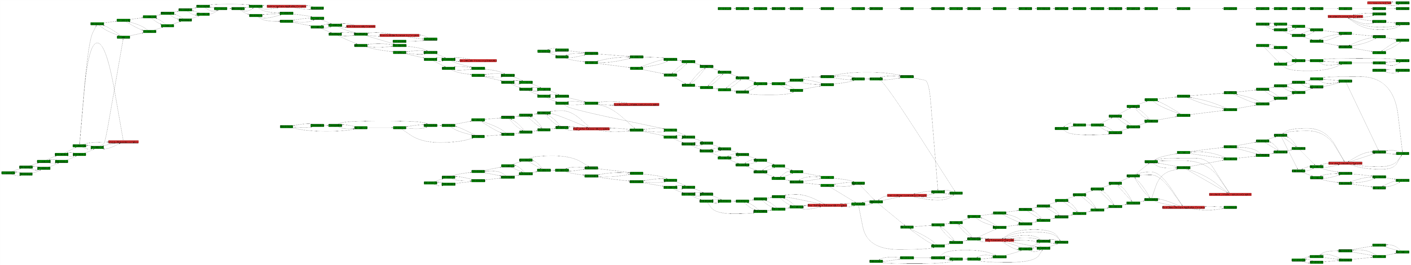
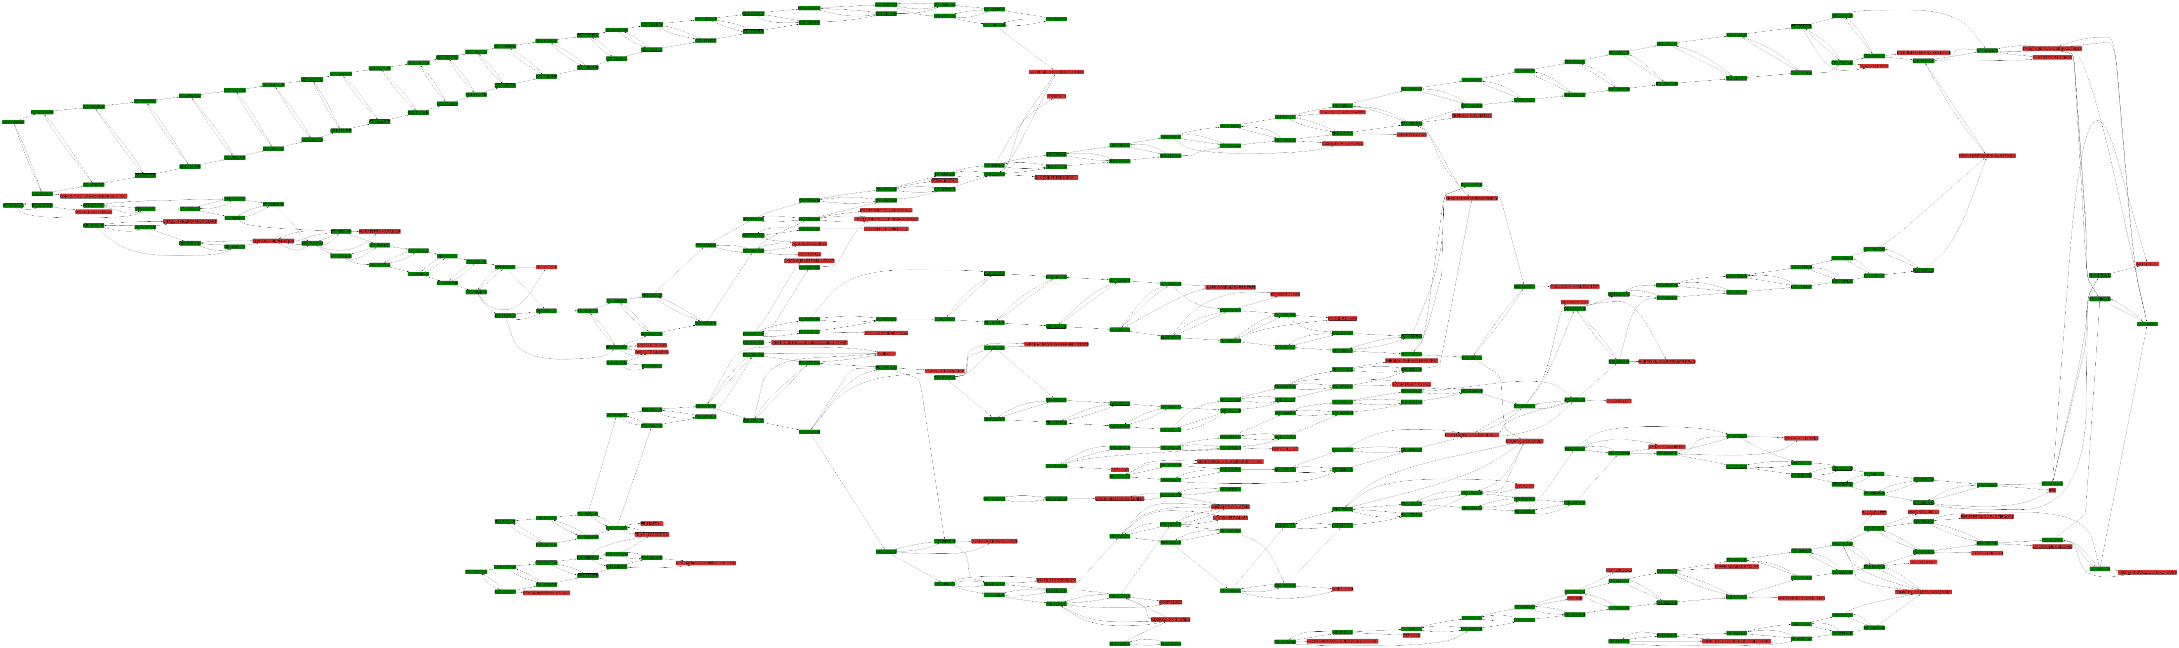
Domain Engineering – Visualization
Aid to understand model stored in database
and spot bugs by simple inspection
Day 43
MSAGL – Automated Graph Layout engine
Day 61

Slide 25
Experiences Summary
Domain Engineering
Solver Engineering
Model Formalization
Data Validation
Constraints
as Code
Develop mathematically precise model
Small Batches
1 process
at a time
Full Model
Visualization
Integers + Uninterpreted Functions
Bit-vectors
+ UF
Relational Object Model of SQL data
Semantic validation
of SQL data
Full Encoding
CSP based on Z3
Partial Encoding
Solved 10% in 20 hrs
Solved 80% in 10 hrs
Dead end
Solved 100% in 3 min

Slide 26




A Fly in the Ointment and a Wasp in the Rose

Slide 27
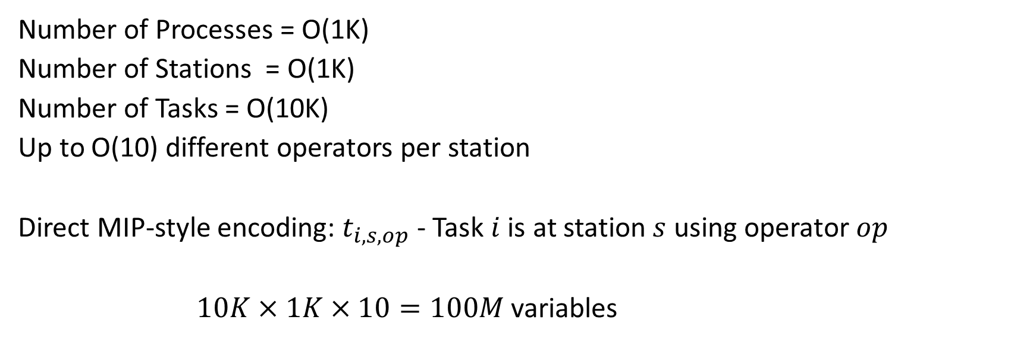
Domain Overload
Number of Processes = O(1K)
Number of Stations = O(1K)
Number of Tasks = O(10K)
Up to O(10) different operators per station
Direct MIP-style encoding: $t_{i,s,op}$ - Task $i$ is at station $s$ using operator $op$
$10K×1K×10=100M$ variables
Our approach: Use uninterpreted functions for “symbolic indices”

Slide 28
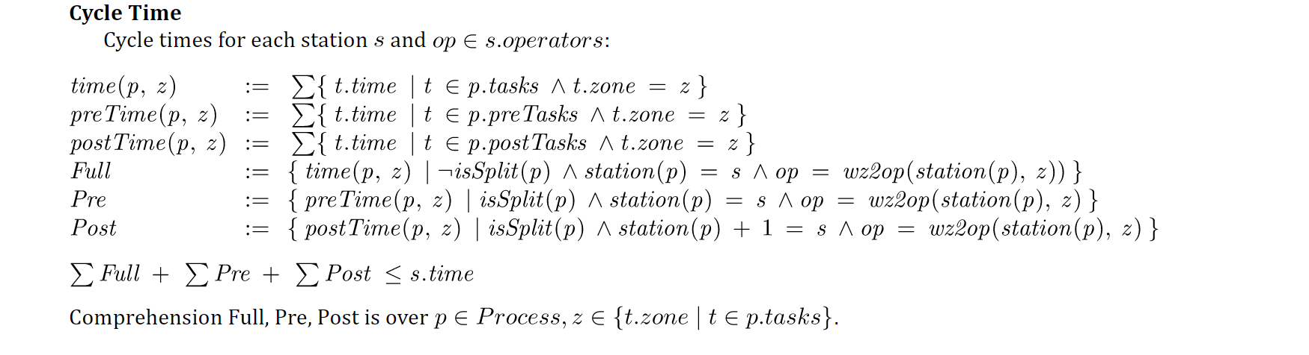
Constraint Overload
a polluting, nasty side constraint
Constrained multi-knapsack:
A set of items, each is added to one knapsack, subject to side-constraints
Our approach: program constraint as an ad-hoc theory

Slide 29
Solver Engineering – Mathematical Modeling
Solve for:
$assign_{p}: Station$ each process $p$
Auxiliary Functions:
$maxHeight:Station →Nat$
$operator:Station×Zone →Operator$
Assignment Constraints:
$operator\left(assign_{p} ,z\right)∈\left\{op_{1},op_{2}\right\}$
$maxHeight\left(assign_{p}\right)≥height_{p}$
Process
Task 1
Task 2
Task 3
Task 4
Task 5
Task 6
Process
Task 1
Task 2
Task 3
Task 4
Task 5
Task 6
Process
Task 1
Task 2
Task 3
Task 4
Task 5
Mapping to Z3 at same the level of model
Uninterpreted functions
Nested formulas (no tuning for big Ms)
Finite domains using bit-vectors
Research Angles
Mathematical concepts matured in tools for requirements capture (TLA+)
A sweet spot for Formal Methods skillsets
Uncovered many subtle implicit assumptions

Slide 30
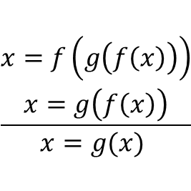
Solver Engineering – Mathematical Modeling
Solve for:
$assign_{p}: Station$ each process $p$
Auxiliary Functions:
$maxHeight:Station →Nat$
$operator:Station×Zone →Operator$
Assignment Constraints:
$operator\left(assign_{p} ,z\right)∈\left\{op_{1},op_{2}\right\}$
$maxHeight\left(assign_{p}\right)≥height_{p}$
Z3 solves for functions not just (integer/real) variables
Maps to specialized solver
Incremental Congruence Closure
Process
Task 1
Task 2
Task 3
Task 4
Task 5
Task 6
Process
$$\frac{\begin{aligned}x=f\left(g\left(f\left(x\right)\right)\right) \\ x=g\left(f\left(x\right)\right)\end{aligned}}{x=g(x) }$$
Task 1
Task 2
Task 3
Task 4
Task 5
Task 6
Process
Allows succinct encodings
of constraints
Task 1
Task 2
Task 3
Task 4
Task 5
Mapping to Z3 at same the level of model
Uninterpreted functions
Nested formulas (no tuning for big Ms)
Finite domains using bit-vectors
Research Angles
Mathematical concepts matured in tools for requirements capture (TLA+)
A sweet spot for Formal Methods skillsets
Uncovered many subtle implicit assumptions
Bit-vectors map to SAT solver technology
Integers map to MIP solver technology

Slide 31
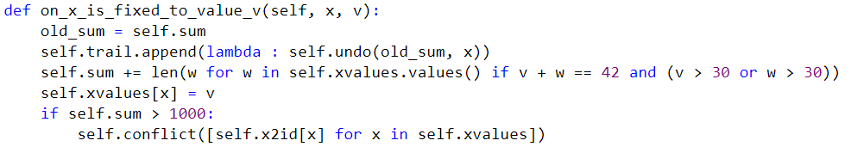
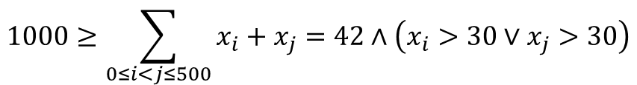
Solver Engineering – Constraints as Code
When supported formalisms lag, or encoding is impractical
As constraints:
O(100K) atomic formulas
$$1000≥\sum_{0≤i<j≤500}{x_{i}+x_{j}=42∧\left(x_{i}>30∨x_{j}>30\right)}$$
As code:
callback + conflicts on demand

Slide 32
Solving Strategy
v1: Pre-solving
Assign a small batch of 4-10 processes to stations at a time
v2: Pre-solving take two
Assign just one process at a time and only encode process constraints when a process gets assigned.
The resulting solver can assign 950 out of 1050 processes in a few minutes.
v3: A custom CDCL / CSP solver
Perform branching and propagation of cycle time constraints on top of repeated calls to Z3.
Maintain backtracking stack and add lemmas based on the chosen branches.
This was complex to engineer and only exercised in preliminary form.
v4: with Custom Propagator and Bit-vectors
With bit-vectors, without cycle-time: solvable in 30 seconds.
With bit-vectors and cycle-time: solvable for 300 processes in a few minutes, but not all processes.
With bit-vectors, programmable-propagator for cycle-time: patching + solving
Stations and processes, station heights and task time are integers
Solved 100 processes very slowly.
Initial: a few hours
Current: a few minutes.

Slide 33
SMT for OR?
Already happened: CP-SAT uses CDCL(T) for OR domains
Approach here: Uninterpreted Functions, Bit-Vectors, Constraints as Code
From experiences to tuning:
LNS for Modulo Theories?
A modernized core solver for Z3: In-processing for SMT?
Sound MIP is too costly for CP: Specialized LP for modular machine arithmetic

Slide 34
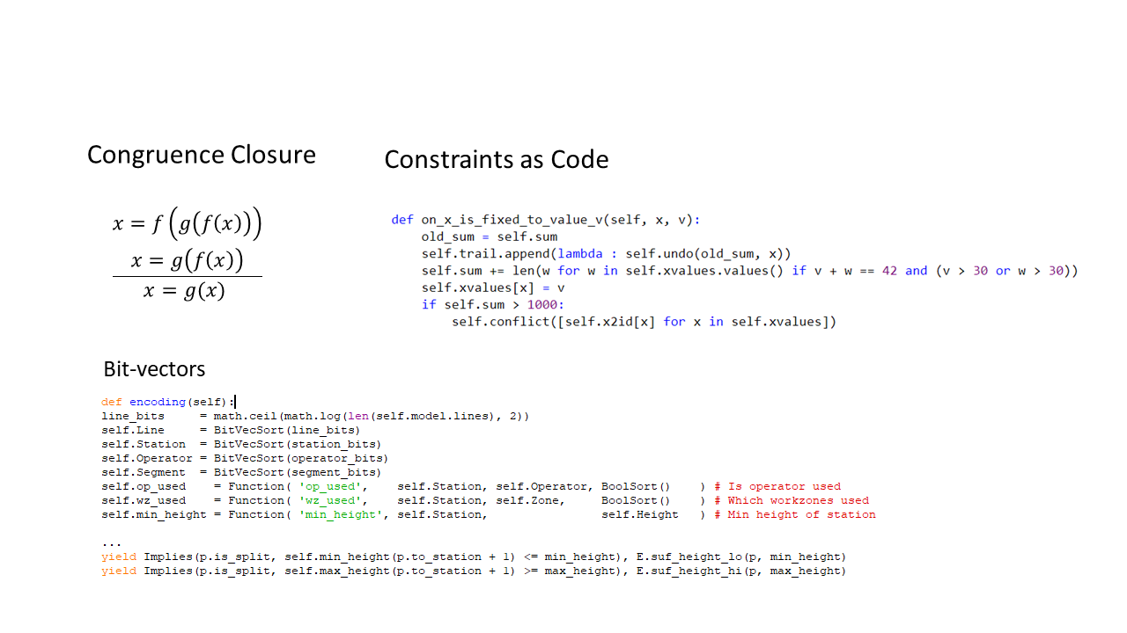
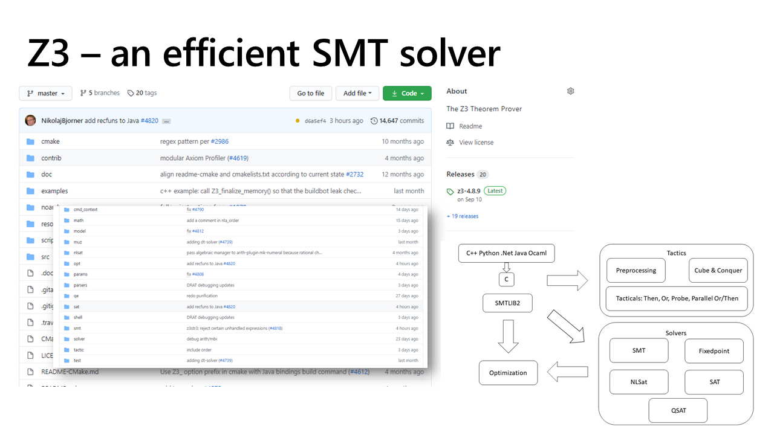
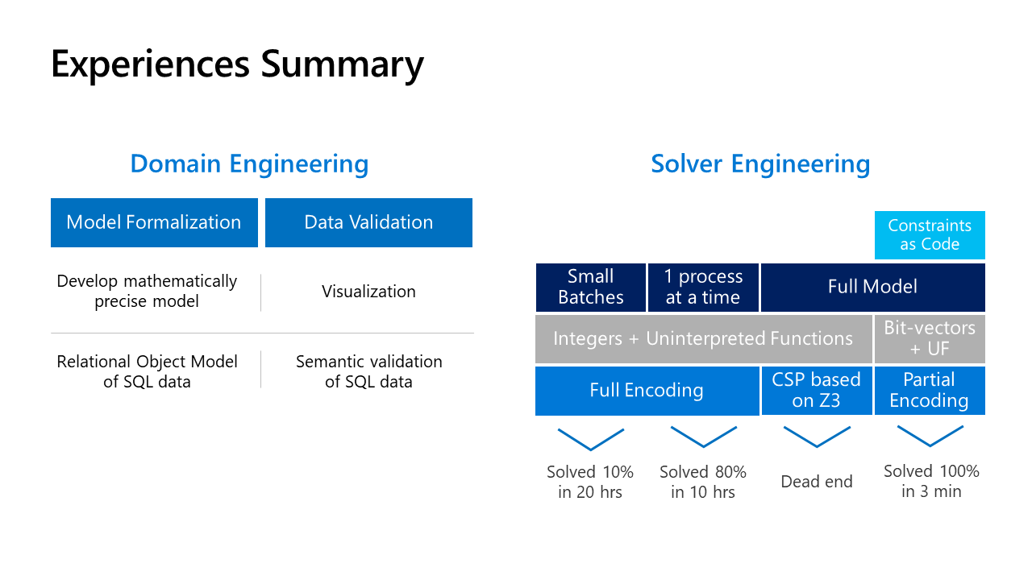
Summary
Theories
Humble Path
Fly in the Ointment
Data Validation
Nimble Constraints

Slide 35
Extra Slides

Slide 36



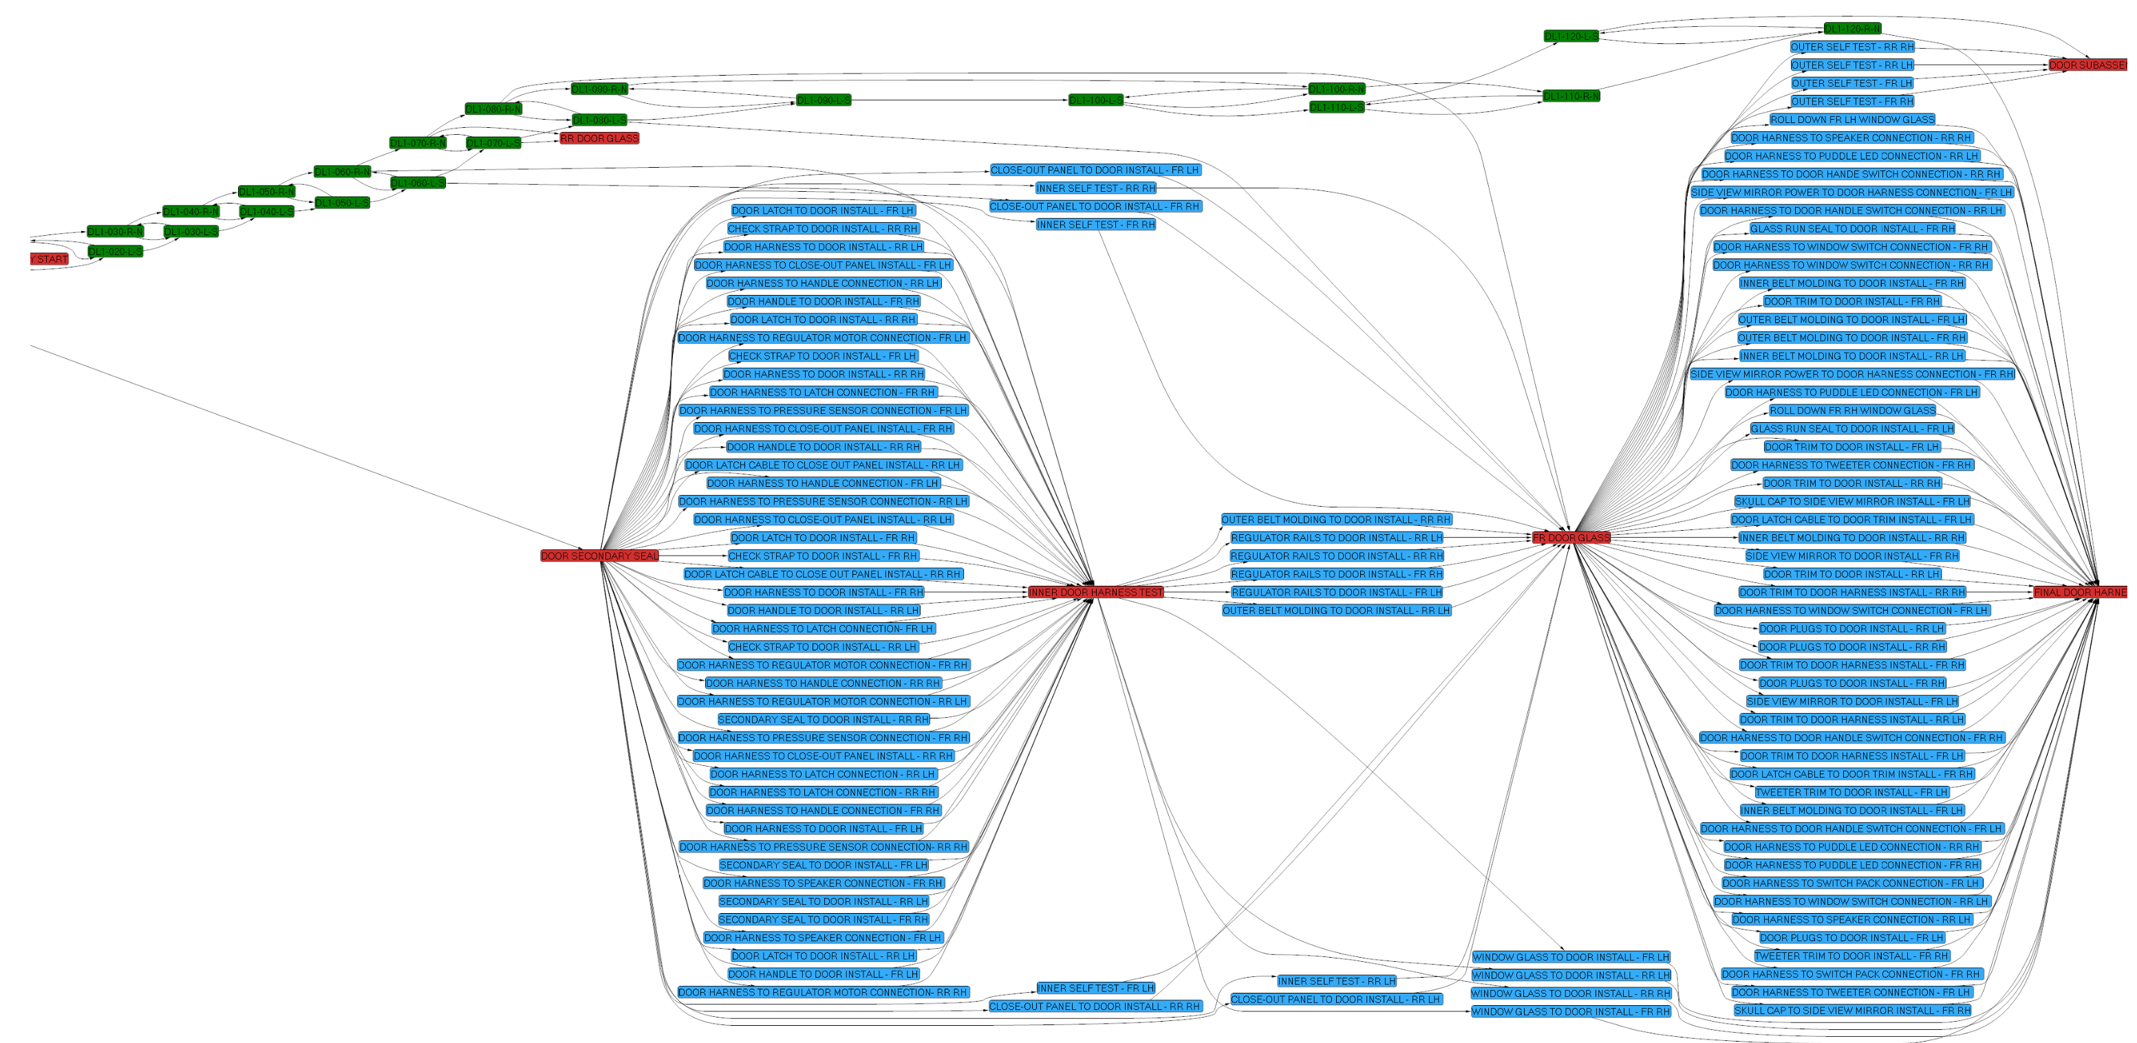






Tools used as part of collaboration
Contact at
Manufacturer
Shared VM
Weekly + ad-hoc sync
Azure Bastion
Microsoft
Automated
Graph Layout
Snapshot
Visualization
Requirements
Object Model
Constraints

Slide 37
Optimization Objectives
Currently at early stage Understanding what best serves our scenario
Likely main objective
Reduce number of operators, reduce number of tools used overall.
First approach is by programmable Branch & Bounding to find a Pareto Front per run.
Research Angles
Pareto Strategies
Any-time optimization
Local Neighborhood search
MaxSAT based on:
Cores
Hitting sets
Correction sets
Branch and bound
Z3 Technologies
Core based MaxSAT
Primal Simplex
Multi-objective optimization: Pareto, Lex, Box
Some years ago Used Azure cloud scaling (cube & conquer) and large neighborhood search to optimize NFL schedules

Slide 38
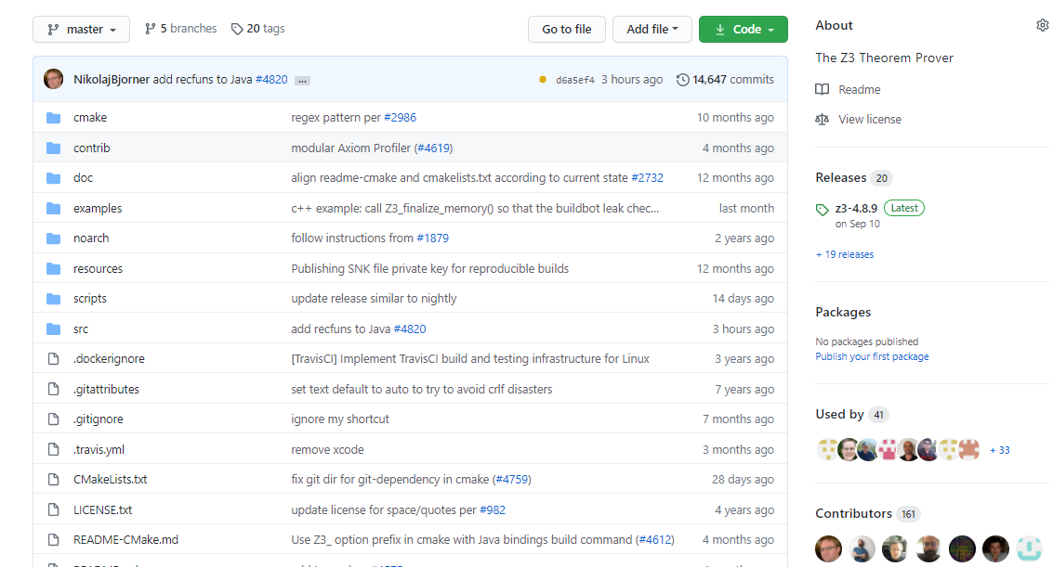
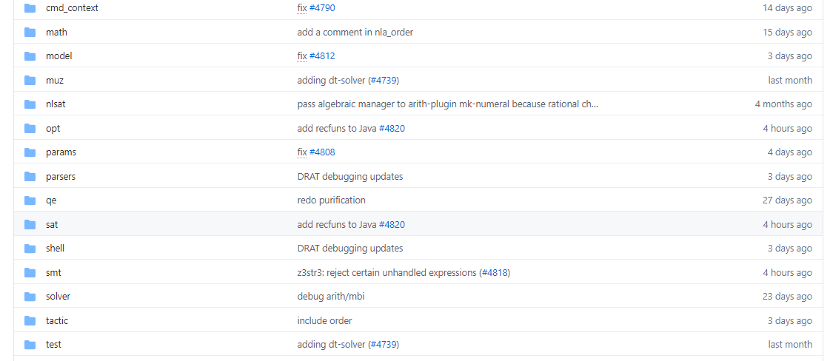
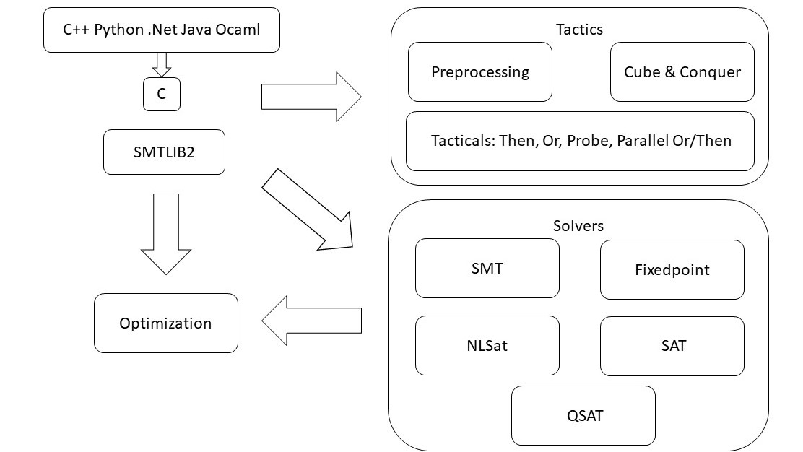
Z3 – an efficient SMT solver

Slide 39
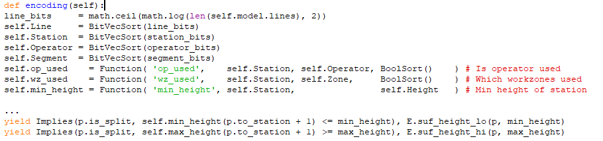
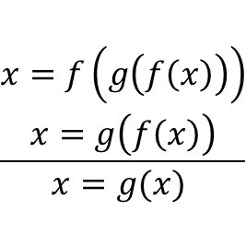
Congruence Closure
Constraints as Code
$$\frac{\begin{aligned}x=f\left(g\left(f\left(x\right)\right)\right) \\ x=g\left(f\left(x\right)\right)\end{aligned}}{x=g(x) }$$
Bit-vectors

